Slide 1


Hands-on PK/PD Data Analysis, Parts 3 and 4
Cancer Bioinformatics Data Science Bootcamp, 2025
Alexandra Partey

Slide 2


Course sessions
Part 1 – Dealing with Real World Data and Basic Data Visualization
Part 2 – Obtaining individual PK profiles and identifying demographic
factor driving PK
Part 3 – PK/PD relationship and PD model parameter estimation
Part 4 – Simulation Run and Precision dosing

Slide 3
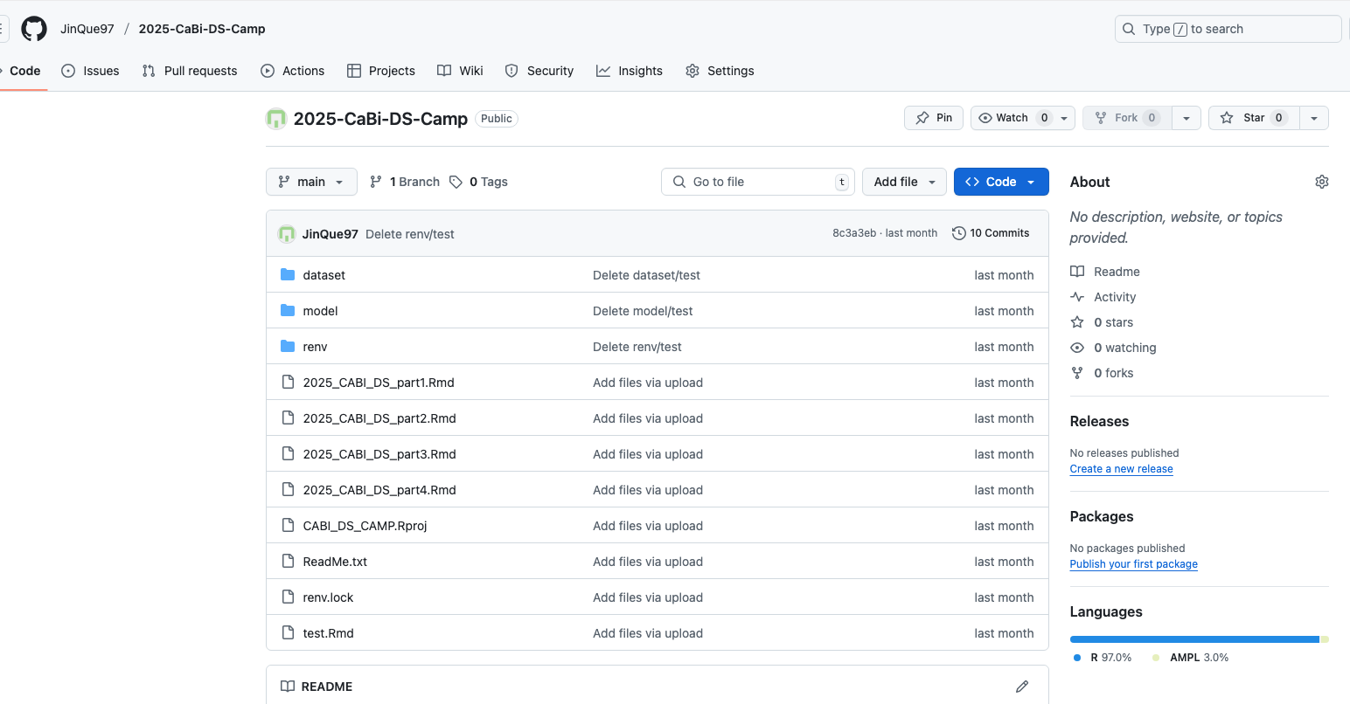
Materials
Use this link for now: https://posit.cloud/content/10469544
You can download a copy here: https://github.com/JinQue97/2025-CaBi-DS-Camp

Slide 4

What are we trying to achieve with these models?

Slide 5
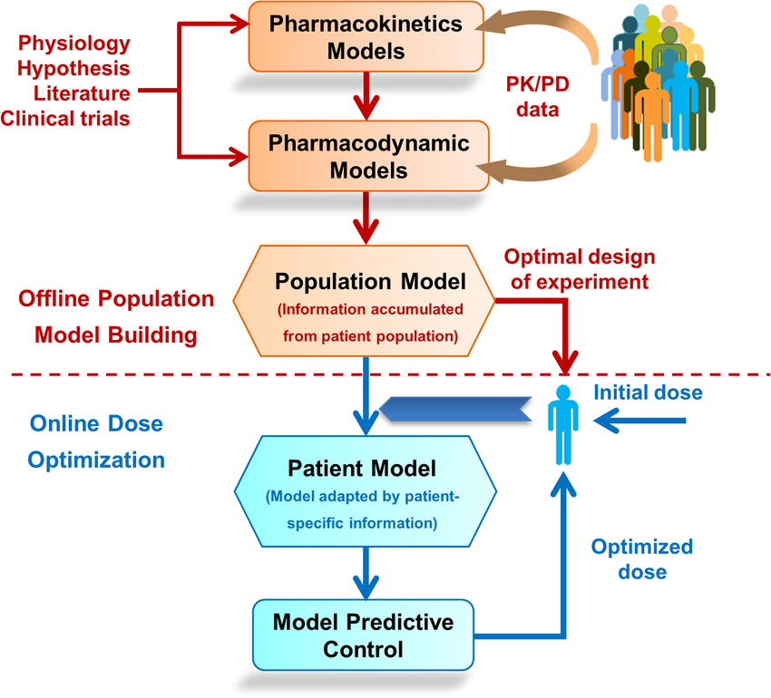
Individualized Medicine
Literature informs models
Models inform trials
Trials inform models
Models inform patient optimized dose

Slide 6
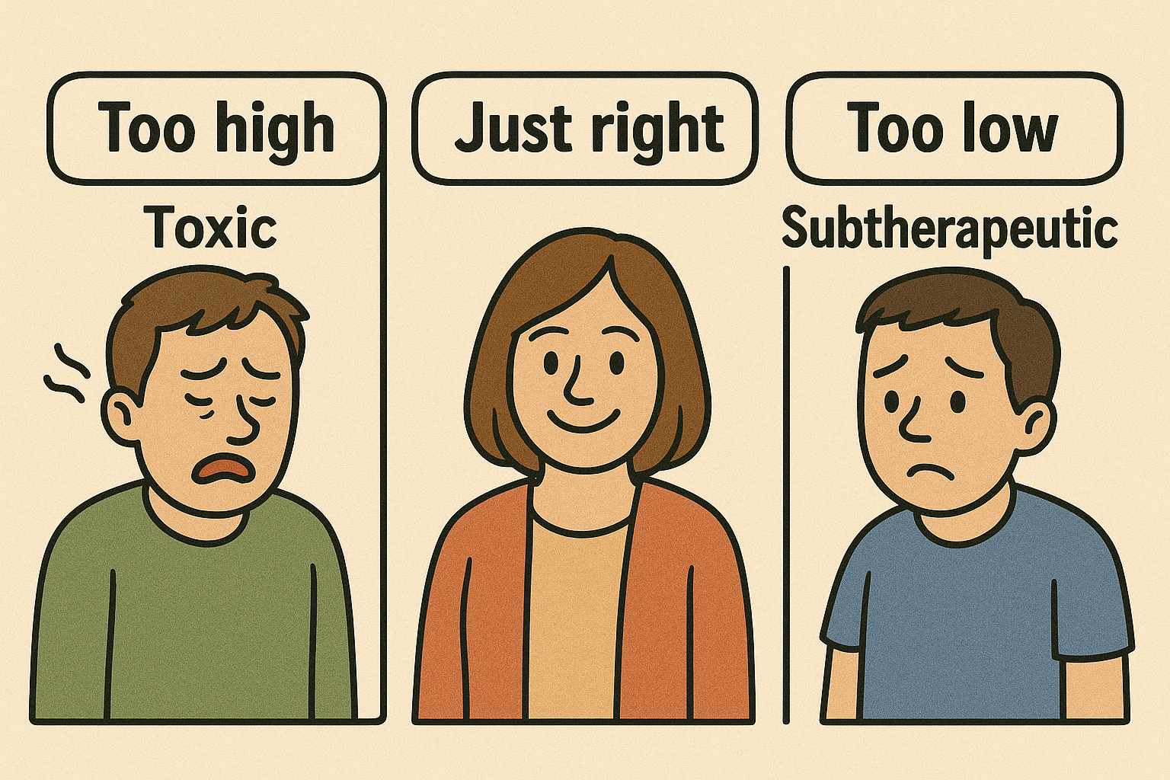
New Drug: KRT-232 aka Navtemadlin

Slide 7
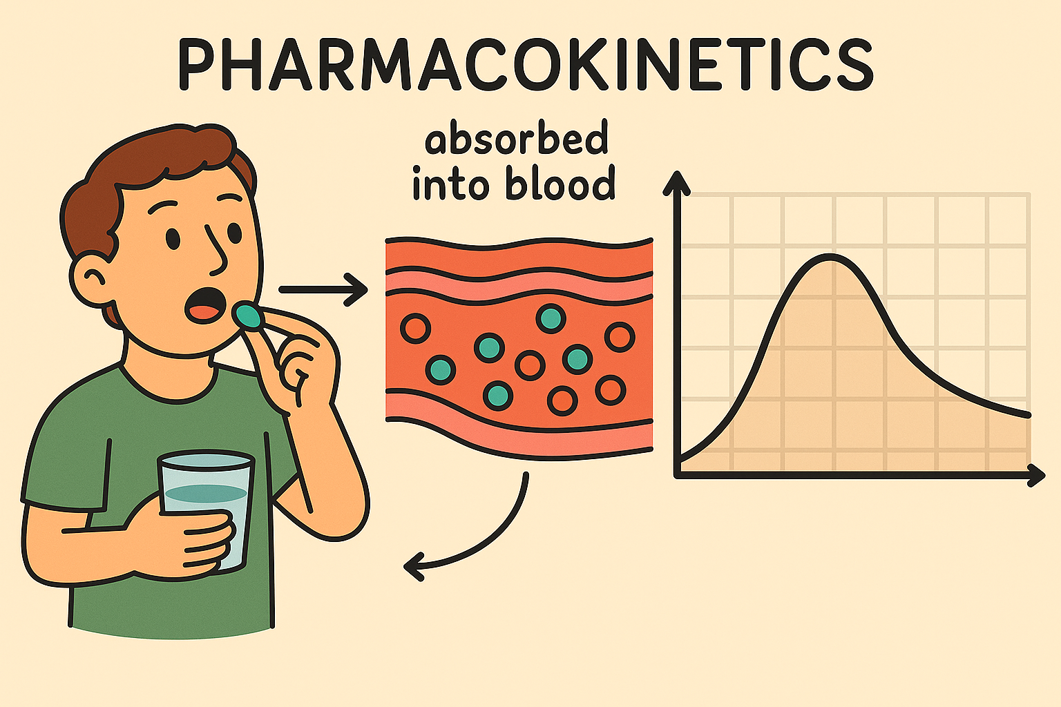
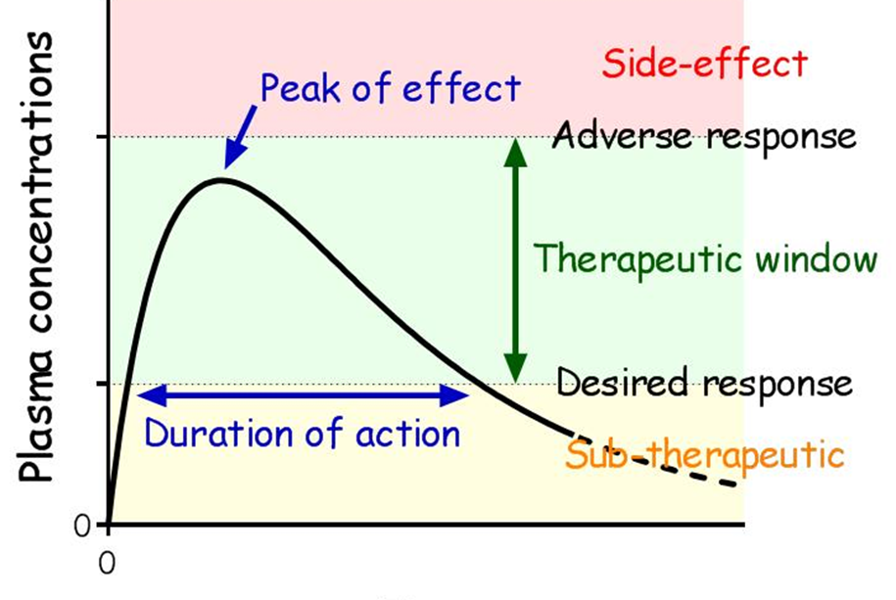

Slide 8
PHARMACODYNAMICS
This tells us what effect the drug has on the body.
For example, for a diabetic, an important pharmacodynamic marker would be blood glucose.
For a hypertensive patient, it is blood pressure.
For our drug KRT-232, it is Macrophage Inhibitory Cytokine-1 (MIC-1).

Slide 9
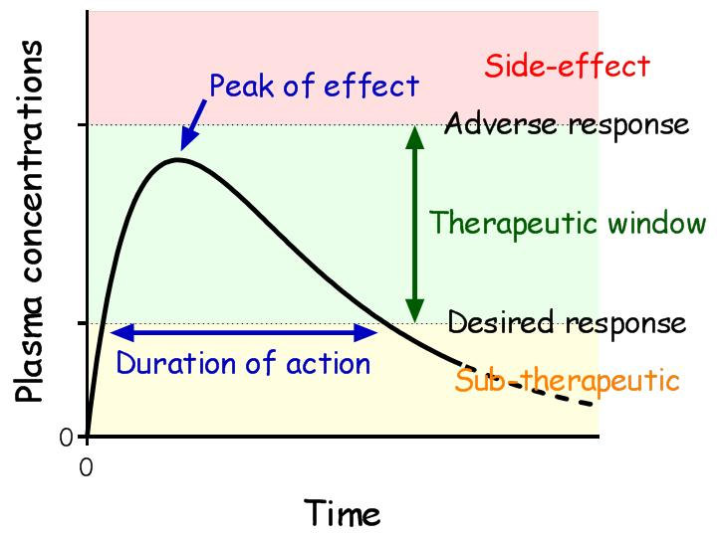
If we have data from 100 patients given KRT-232 and their PK Curves and their PD Curves, can we determine the right dose for each patient?
Notes:
What factors determine the curve parameters?

Slide 10
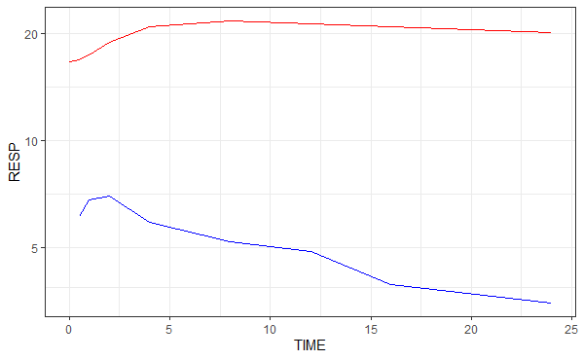
PD marker(MIC-1) concentration
Drug concentration

Slide 11
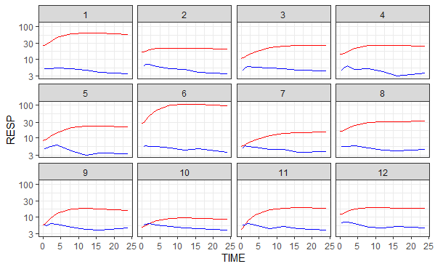
What do we notice about the first 12 patients.
VARIATION!!
Age
Weight
Disease severity
Genetics
Different people, different responses: this is why we personalize treatment!

Slide 12
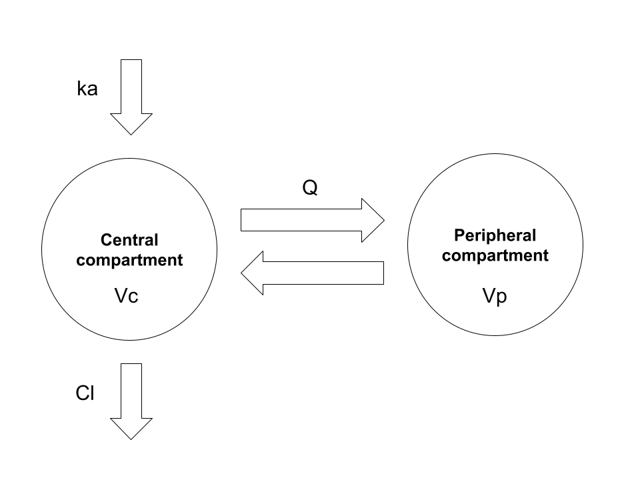
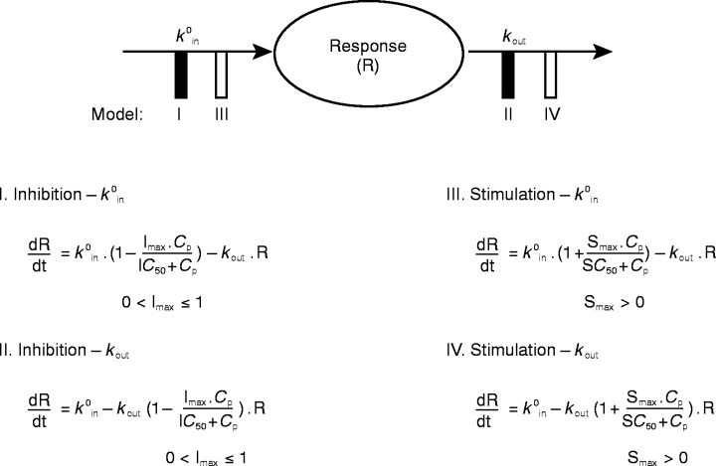
Remember our model?
Model = Combination of structural (PK mathematical equations) + statistical concepts
KRT-232 Defined Model (PK and PD)
Defined Model + Measured data (KRT-232 / MIC-1 conc vs time) = predicted Individual parameter values (V and Cl) -> Parameter Estimation
PK – 2 compartment with absorption model
PD – Indirect response (Turnover) model

Slide 13
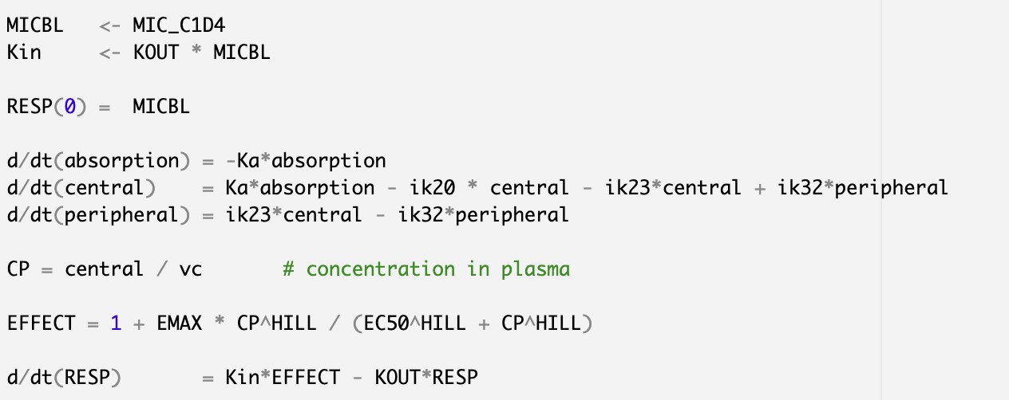
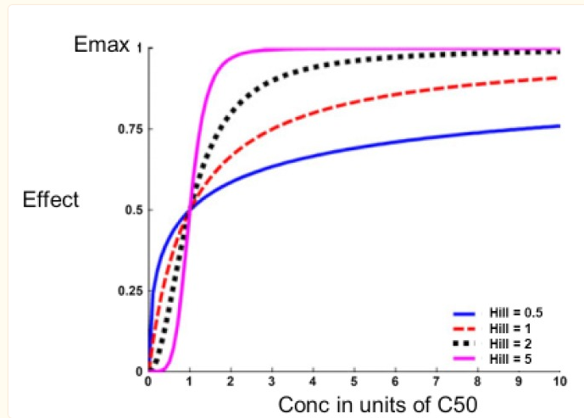
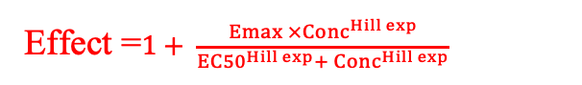
PK/PD Model
Drug Administered by mouth 60mg
Absorption
site
Ka
In our code
Central
compartment
K23
Peripheral compartment
Clearance
K20
K32
Kin × Effect
K20 = CL/Vc
K23 = Q/Vc
K32 = Q/Vp
Effect =$1+ \frac{Emax ×{Conc}^{Hill exp}}{{EC50}^{Hill exp}+ {Conc}^{Hill exp}}$
Response
Kout × Effect

Slide 14
Definitions
Emax: The maximum effect a drug can produce.
EC50 (Effective Concentration 50%)Definition: The drug concentration at which 50% of the maximum effect (Emax) is achieved. It reflects the potency of a drug.
A lower EC50 means a more potent drug ,it needs less to be effective.
Hill coefficient: this describes the steepness of the concentration-effect curve.
Hill > 1 = steeper curve → small changes in concentration cause big changes in effect.
Hill < 1 = flatter response curve.

Slide 15
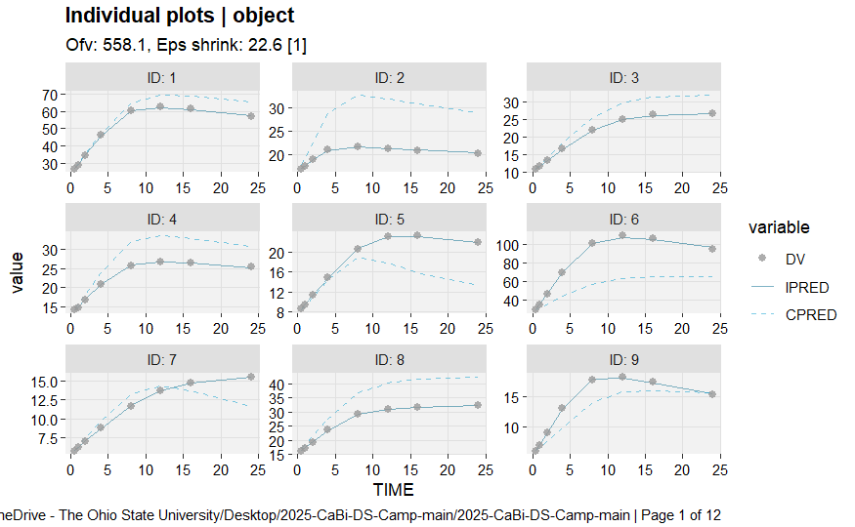
Model Diagnosis
IPRED: Does the model explain what actually happened in this patient?
CPRED: What would the model predict if everyone responded like the average person?
Notes:
IPRED: Predicted response for a specific individual, based on their unique estimated parameters (random effects).
Usage: Helps check how well the model fits each individual’s data.
You want IPRED to closely match observed responses.
CPRED (Conditioned on fixed effect model):Predicted response using only the fixed effects, assuming the person is “average” (no random variation).
Usage:
Evaluates how well the model predicts in general, across the population.
Diagnostic Plot:
DV vs. CPRED — can show bias if the model systematically under- or overpredicts.

Slide 16
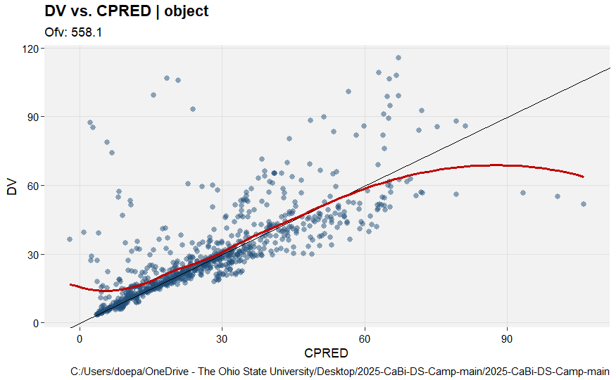
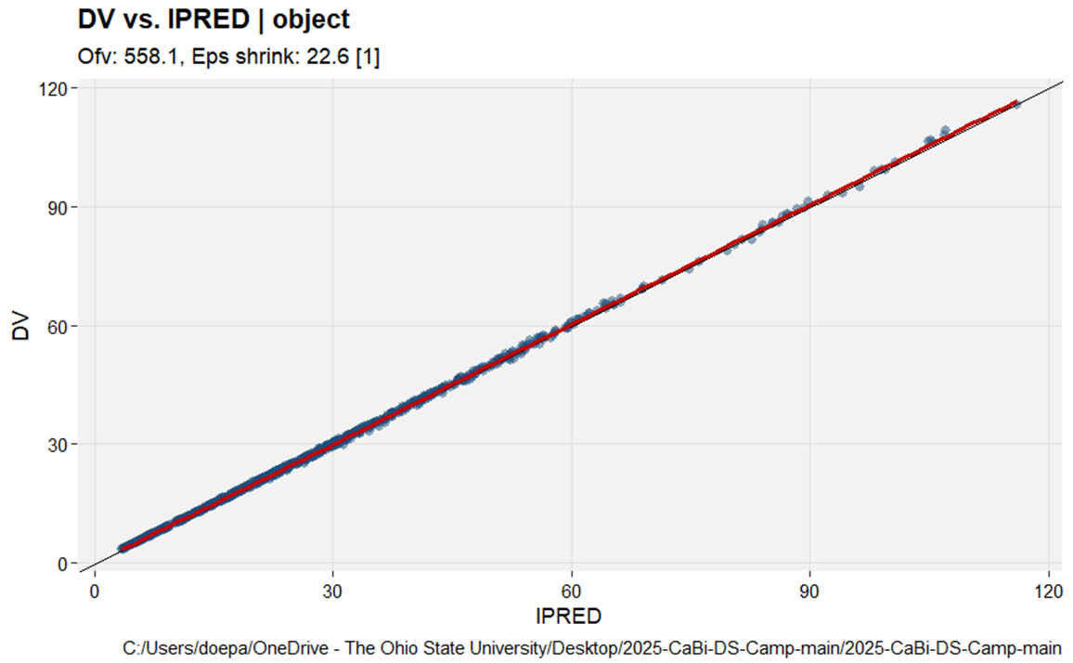
Model Diagnosis
Notes:
Dv vs IPRED: Points close to the diagonal 45° line ,means model fits individual data well.
DV vs CPRED: Prediction using only fixed effects (the “average person”), Ignores personal variability, assumes everyone is the same.
Helps determine
Whether the model structure is capturing the overall trend across the population
Detects systematic bias (e.g., always underpredicting high values)
The Points should still be close to the diagonal line, but you expect more scatter than with IPRED

Slide 17
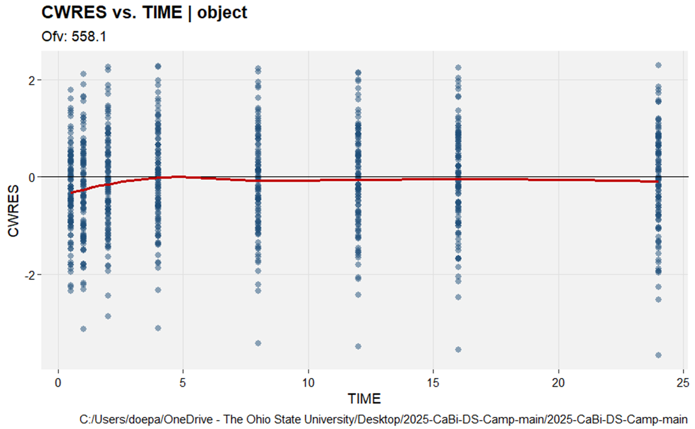
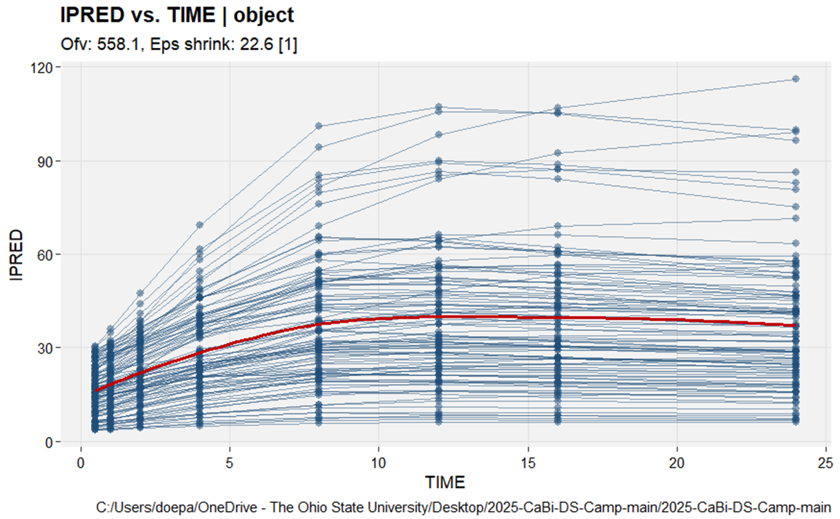
Model Diagnosis
Notes:
CWRES = Conditional Weighted Residuals.
These are standardized residuals (differences between observed and predicted values),
Why plot CWRES vs TIME?
To detect: Time-dependent bias (e.g., underprediction at early times, overprediction later)
What You Want to See: Residuals scattered randomly around, No trend over time, No obvious pattern (e.g., curved or clustered)
IPRED vs TIME
To
Understand how the predicted response for each individual evolves over time
Detect model drift or temporal bias
Compare to observed values (in parallel with DV vs TIME)
What You Want to See:
Smooth, reasonable pattern that matches expected drug effect or concentration profiles over time

Slide 18
Questions?

Slide 19
PART 4

Slide 20
Individualized Medicine
Literature informs models
Models inform trials
Trials inform models
Models inform patient optimized dose

Slide 21
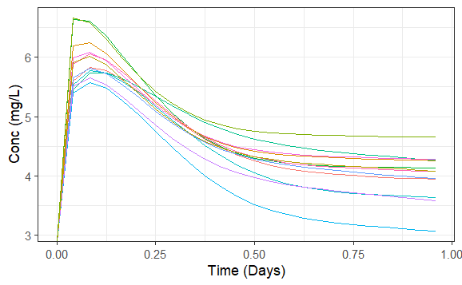
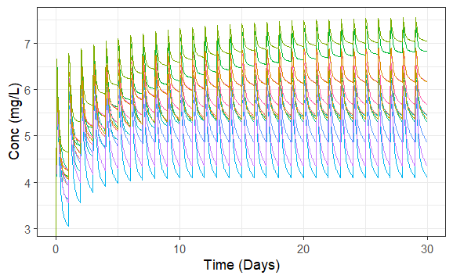
Simulated PK Curves

Slide 22
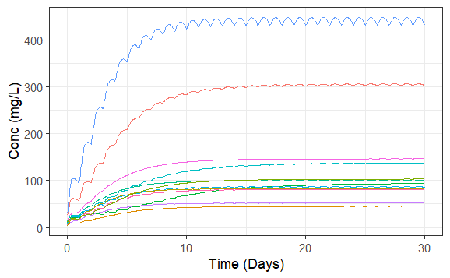
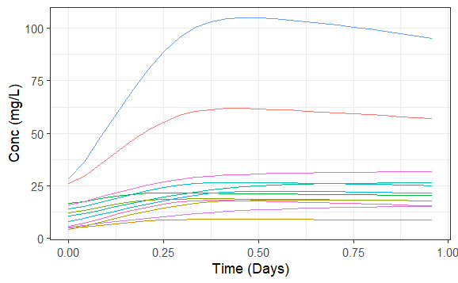
Simulated PD curves

Slide 23
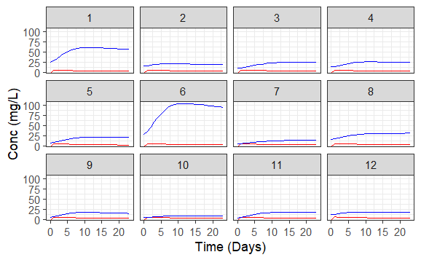
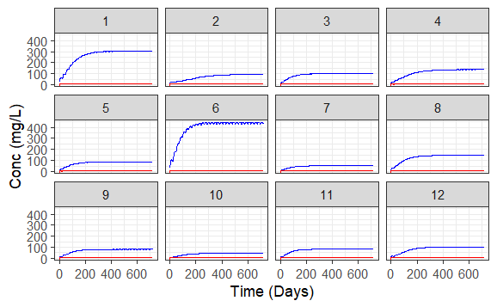
Simulated PK/PD for first 12 patients

Slide 24
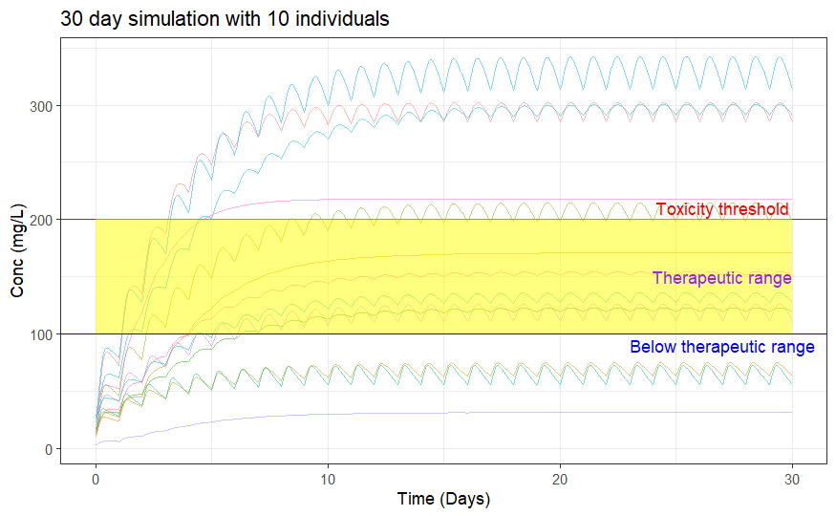

Slide 25
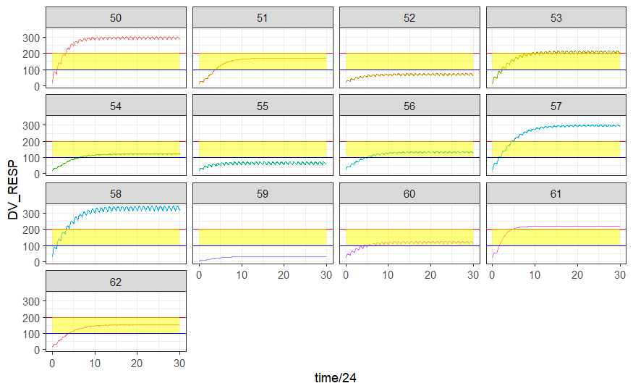

Slide 26
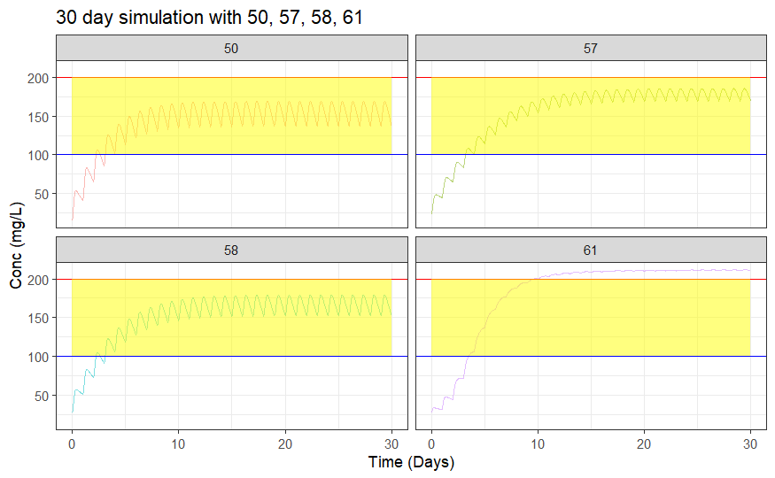
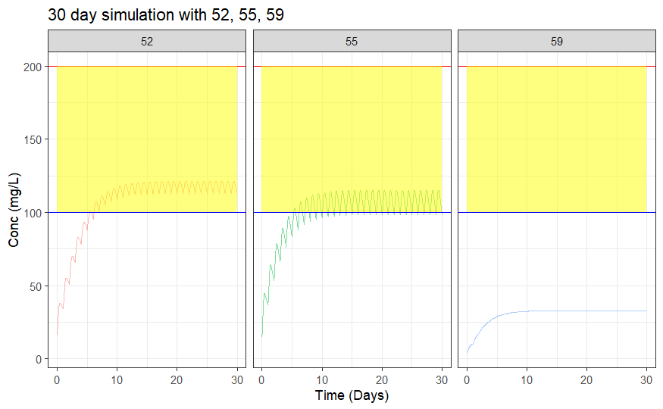
Dose Adjustments
# 50, 57, 58, 61 - Reduce dose
# 52, 55, 59 – Increase dose

Slide 27
# Using Interactive Tool
Click [here](bimvptest.shinyapps.io/precision_dosing/) for running interactive tool.

Slide 28
Questions?

Slide 29


